Slide 1
CIM Overview
Presenter: Manoj Kumar Mohanty

Slide 2
WHAT IS CIM ?
The IEC 61970 series of standards deals with the application program interfaces for energy management systems (EMS). The series provides a set of guidelines and standards to facilitate:
Part 3XX: Common Information Model (CIM)
Common Information Model (CIM)
In electric power transmission and distribution, the Common Information Model (CIM), a standard developed by the electric power industry that has been officially adopted by the International Electrotechnical Commission (IEC), aims to allow application software to exchange information about an electrical network.
Taken from
https://en.wikipedia.org/wiki/IEC_61970
https://en.wikipedia.org/wiki/Common_Information_Model_(electricity)

Slide 3
The IEC Standards for Power System Model Exchange
The CIM translated into the industry standard eXtensible Markup Language (XML):
Uses a standard XML format that any EMS can understand using standard Internet and/or Microsoft technologies
IEC 61970 series of standards
Part 301 CIM Base
Specifies UML model
Parts 452 and 456 CIM Model Exchange Specification
Specifies guidelines for the definition of specific profiles (or subsets) of the CIM for particular power system model exchange requirements
Part 501 CIM RDF Schema
Specifies mapping between UML model and XML model using RDF Schema
This was mandated by NERC for exchange of models between Reliability Coordinators
Part 552 CIM XML Model Exchange Format
Specifies simplified RDF Schema and extensions to transfer incremental updates via difference file

Slide 4
Sample Power System Model
Company
Load Area
Belongs To
Member Of
Owns
Operates
Operates
Connects To
Connects To
Connects To
Load
Generator
AC Line
Substation

Slide 5
WG13 CIM Packages - 61970
Notes:
OK

Slide 6
Concepts: Generalization/Inheritance
Breaker: Specialization of ProtectedSwitch
ProtectedSwitch: Specialization of Switch
Switch: Specialization of Conducting Equipment
ConductingEquipment: Specialization of Equipment
Equipment: Specialization of PowerSystem Resource

Slide 7
Equipment Inheritance Hierarchy

Slide 8
Naming Hierarchy 1

Slide 9
Naming Hierarchy 2

Slide 10
Connectivity and Topology Model

Slide 11
Converting a Circuit to CIM Objects
Example to show how voltage levels, current transformers, power transformers and generators are modelled
Circuit contains a single generating source, load, line and busbar. The circuit also contains two power transformers resulting in three voltage levels of 17kV, 33kV and 132kV
Taken from McMorran, “An Introduction to IEC 61970-301 & 61968-11: The Common Information Model”, University of Strathclyde, Glasgow, UK

Slide 12
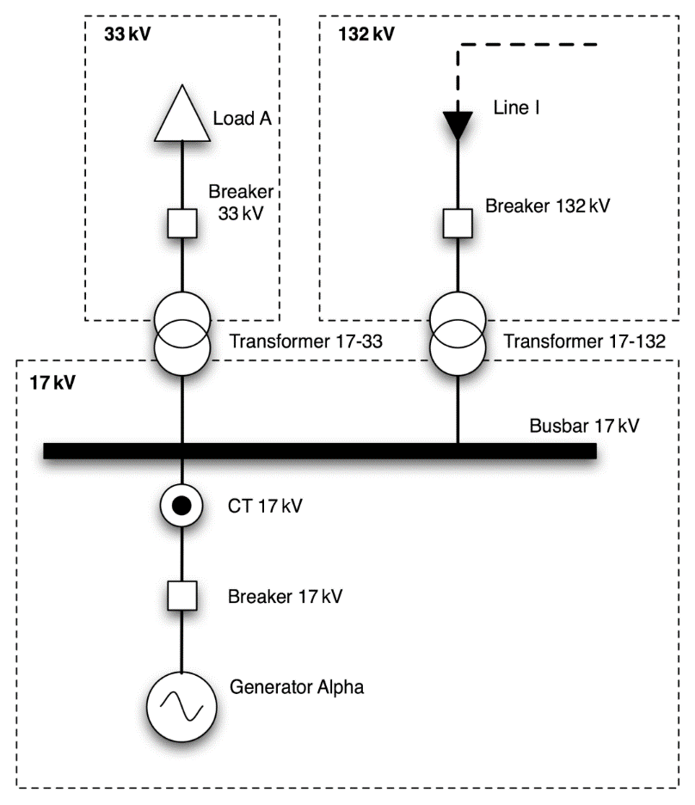
Example Circuit as a Single Line Diagram
EnergyConsumer
ACLineSegment
Breaker
Breaker
BusbarSection
Breaker
GeneratingUnit
Current measurement represented by Measurement connected to Terminal
SynchronousMachine

Slide 13
Representing a Power Transformer as CIM Objects
A power transformer is not mapped to a single CIM class
Represented by a number of components with a single PowerTransformer container class
Two-winding power transformer becomes two TransformerWinding objects within a PowerTransformer container
If a tap changer is present to control one of the windings
An instance of the TapChanger class is associated with that particular winding
Also contained within the PowerTransformer instance

Slide 14
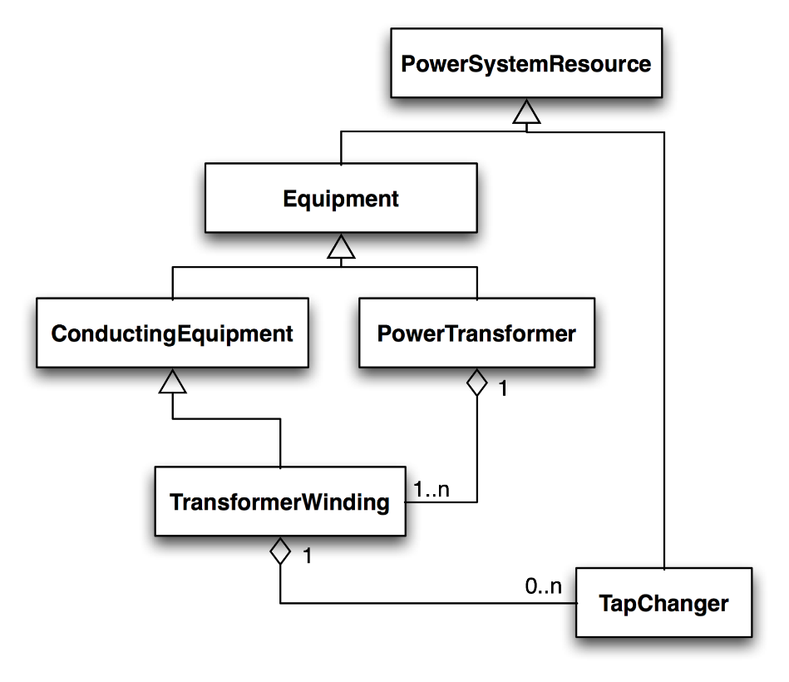
Transformer Class Diagram
Shell of transformer, containing windings, insulation, magnetic core, etc.
Inherits from Equipment, since does not conduct electricity
Part of TransformerWinding, not separate piece of equipment
Physically connected to network and conducts electricity, so inherits from ConductingEquipment

Slide 15
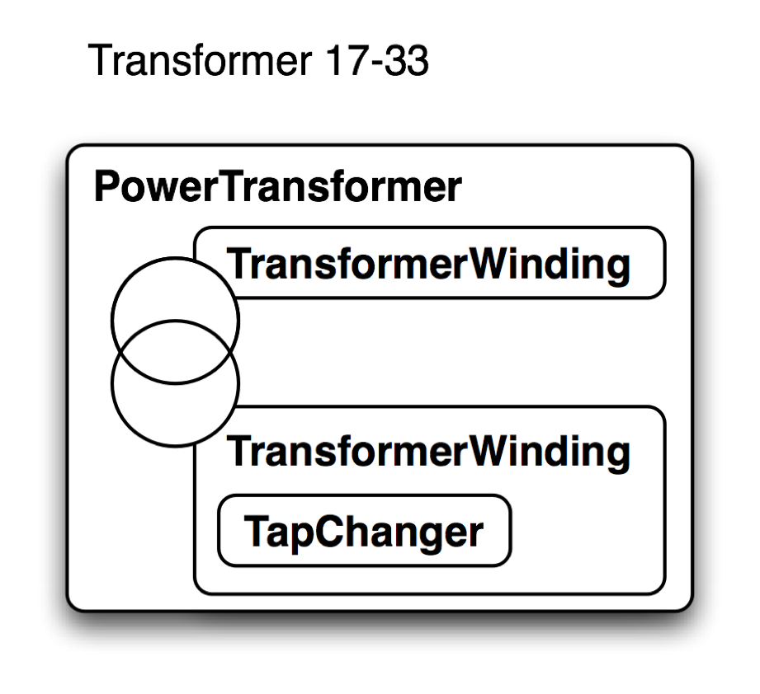
CIM Mapping for Transformer 17-33
Transformer 17-33 is represented as four CIM objects

Slide 16
Transformer Model Diagram from 61970-301CIM Base
PowerSystemResource
(from Core)
Equipment
PowerTransformer
TapChanger
(from Core)
0..n
+PowerTransformer
0..n
0..n
1
0..n
1
1
1
+TapChangers
+TapChangers
+HeatExchanger
+MemberOf_PowerTransformer
0..1
0..1
HeatExchanger
+Contains_TransformerWindings
+RegulationSchedule
1..n
0..1
1
0..1
ConductingEquipment
TransformerWinding
RegulationSchedule
(from Core)
+TransformerWinding
0..n
0..n
1
1
+From_TransformerWinding
+To_TransformeWindings
+To_WindingTest
+From_WindingTests
1
0..n
WindingTest
Notes:
OK, increase font size

Slide 17
Transformer Winding Attributes
 | Transformer Winding
b: Susceptance insulationKV: Voltage connectionType: WindingConnection emergencyMVA : ApparentPower g: Conductance grounded: Boolean r: Resistance r0: Resistance ratedKV: Voltage rated MVA: ApparentPower rground: Resistance shortTermMVA: ApparentPower windingType: WindingType x: Reactance x0: Reactance xground: Reactance

Slide 18
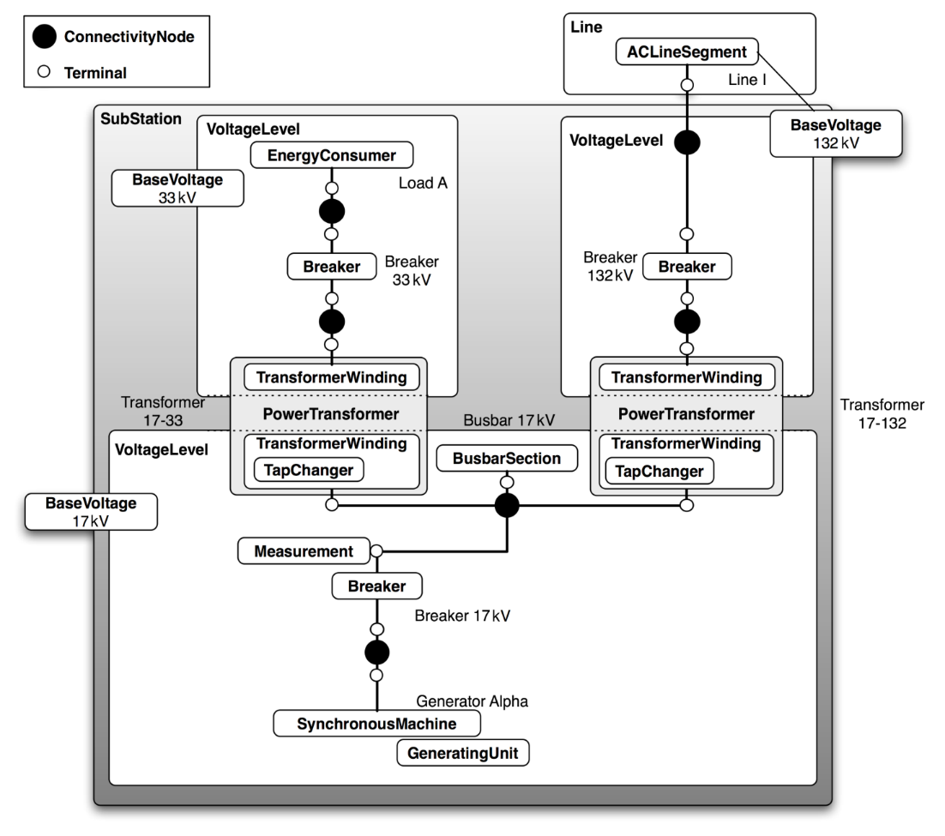
Example Circuit with Full CIM Mappings
Maps to
17 CIM classes
45 CIM objects
Could be extended further with addition of objects for
control areas
equipment owners
measurement units
generation and load curves
asset data

Slide 19
How The CIM Handles Location For Logical Devices And/Or The Physical Asset Performing The Device’s Role

Slide 20
Types Of Document Relationship Inherited By All Assets

Slide 21
Activity Records

Slide 22

Transformer Class Diagram in CIM

Slide 23
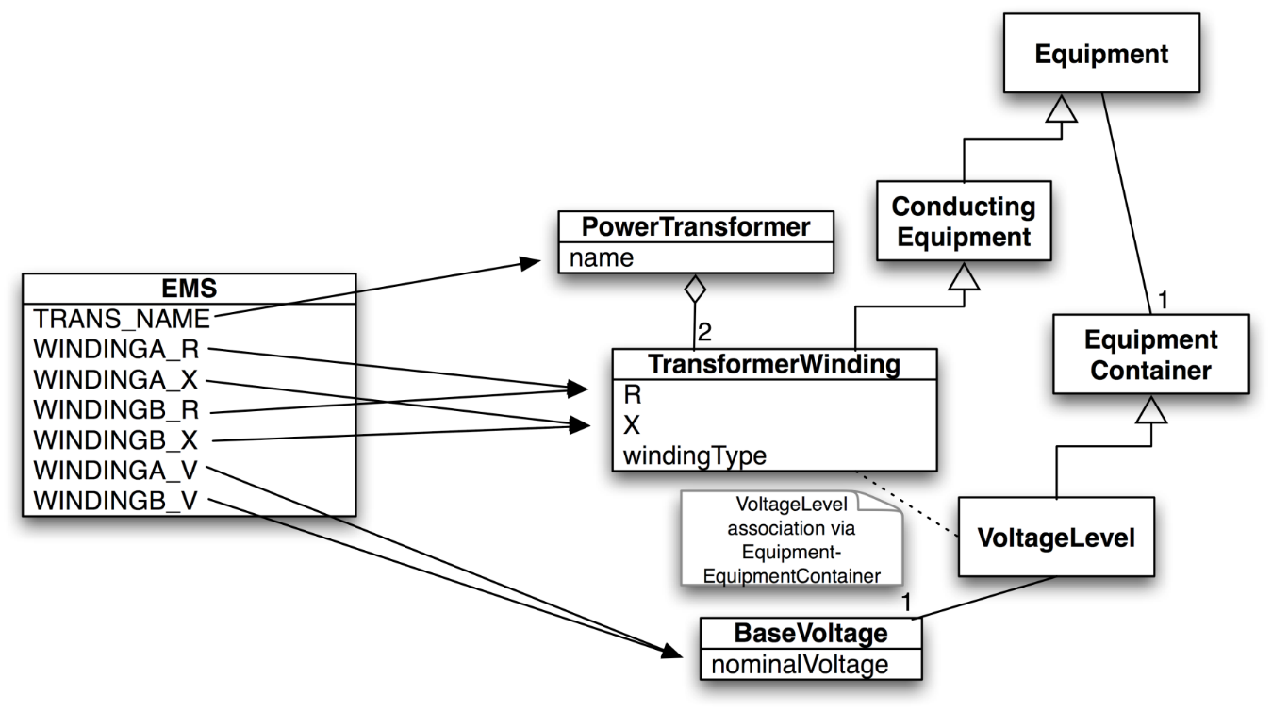
CIM Interface Mapping - Beginnings of Profile/Message Payload Definition
Two different interface attributes (WINDINGA_R and WINDINGB_R) map to same CIM attribute
Aggregation changed from 0..n to 2
Multiplicity changed from 0..1 to 1
Multiplicity changed from 0..1 to 1

Slide 24
Transformer Model Diagram from 61970-301CIM Base
PowerSystemResource
(from Core)
Equipment
PowerTransformer
TapChanger
(from Core)
0..n
+PowerTransformer
0..n
0..n
1
0..n
1
1
1
+TapChangers
+TapChangers
+HeatExchanger
+MemberOf_PowerTransformer
0..1
0..1
HeatExchanger
+Contains_TransformerWindings
+RegulationSchedule
1..n
0..1
1
0..1
ConductingEquipment
TransformerWinding
RegulationSchedule
(from Core)
+TransformerWinding
0..n
0..n
1
1
+From_TransformerWinding
+To_TransformeWindings
+To_WindingTest
+From_WindingTests
1
0..n
WindingTest
Notes:
OK, increase font size

Slide 25
Sample Transformer Interface Message Payload in XML

Slide 26
CIM Header Contents
Namespaces - provide a simple method for qualifying element and attribute names used in XML documents by associating them with namespaces identified by URI references:
Status: WC3 Recommendation 14-January-1999
http://www.w3.org/TR/REC-xml-names/
URI (Uniform Resource Identifiers) - provide a simple and extensible means for identifying a resource:
Status: Internet RFC August 1998
ftp://ftp.isi.edu/in-notes/rfc2396.txt

Slide 27
Simple Network Example

Slide 28
Simple Network Connectivity Modeled with CIM Topology
T1
T2
BDD-RSK2

Slide 29
ACLineSegment in RDF

Slide 30
ACLineSegment in RDF

Slide 31
Containment in RDF
Substation VOL with 230 KV voltage level and Bay 240W79 with Breaker CB
Further down in document

Slide 32
Measurement in RDF

Slide 33
Implementation Syntax – WG13 61970
Part 501 specifies the translation of the CIM in UML form into a machine readable format as expressed in the Extensible Markup Language (XML) representation of that schema using the Resource Description Framework (RDF) Schema specification language
The resulting CIM RDF schema supports CIM Model Exchange specifications, as presented in IEC 61970-452 and others
Part 552 describes the CIM XML format at a level for implementation to support the model exchange requirements in IEC 61970-452
This standard relies upon the CIM RDF Schema of IEC 61970-501

Slide 34
Practical Case of NLDC
5 Full model CIM files from each region NRLDC, NERLDC, ERLDC, SRLDC & WRLDC has been provided by NLDC on 14-Nov-2017.
Single Station CIM file provided only by NRLDC – Siemens. (analysis in next slide)
Single Station CIM file are yet to be provided for analysis from NERLDC, SRLDC, WRLDC & ERLDC.
Predictions by Project Team:
ok, we got the CIM files. As per Ideal case, if the CIM files are as per IEC standard, we can import into OpenNET and get the Network topology.
(but we hadn’t considered for how to make SCADA, ICCP and Display from CIM that time.).
To tackle the worst case scenario, out CBT team had converted the SCADA, ICCP, OPENET, & All SLD display into OSI format from ALSTOM. But all the display couldn’t be converted, and the quality of the output is also not 100% satisfactory and same case for the databases.
We were almost prepared to move forward with the CBT converted DB & Displays keeping aside CIM Approach.
Also we were thinking of a idea to show case the CIM Studio (which is under development stage) in the future to customer, which can take the CIM xml file as input and it can create all db and sample displays from the input file.
After insist from the Customer we considered to go with the CIM file approach finally.

Slide 35
Practical Case of NLDC (contd..)
Now things are not as smooth as it were seemed to be. There are multiple practical roadblocks in the CIM file approach. Which are listed in the trailing lines.
Initial Analysis sent by OSI to POWERGRID/POSOCO dated 20/11/2017 for CIM files provided on 14/11/2017.Major points of Initial analysis were:
Now we have 3 different version for CIM files, each following their own methodology to create the CIM file output.
SR,WR & NER (GE) – CIM Ver 15
ER (OSI)– CIM Ver 13
NR (SIEMENS)– CIM Ver 12
In case of NRLDC, the file received was not a CIM file itself, and in case of WRLDC and SRLDC the rdf:ID format wasn’t correct as per CIM standard. It should have contain 32 character instead of 19 character. But later we have found out that OSI OpenNet can accept the rdfid evenif it is 19 chars, but it should be unique.
Single Station CIM file of NRLDC (ABDUL.XML) was provided to OSI on 21/11/2017.Major points of Initial analysis were:
Selective export for station doesn’t have any Area and Company reference.
There are lots of orphan connectivity for devices found.

Slide 36
Practical Case of NLDC (contd..)
Further Analysis and additional issues were sent by OSI to POWERGRID/POSOCO on 28/11/2017. Major points were:
The import from the RLDC xml files failed with several errors corresponding to measurement ID’s pointing to a non-existent terminal.
The files doesn’t have rdf:ID’s nor a mapping file for any of the electrical device equipment in the PSS network model.
The single station file ml file has following critical errors:
ERROR: Station has non-existent Area and Company
ERROR Voltage Level has non-existent BaseVoltage
ERROR: Connectivity Node has non-existent Equipment Container

Slide 37
OSI’s Response to NLDC:
DBQuality should be owned by the RLDC, no way for OSI to know which is inadvertent DB modelling error or otherwise.
POWERGRID/POSOCO to ensure the availability of the Single Station CIM files from each of the region, as of now only NRLDC single station file is provided.
For building the NLDC DB using CIM from RLDC’s, each of the RLDC will need to provide selective export of their data (per area and/or station) in xml format along with corresponding mapping file (which will have the rdf:ID’s).
The selective export (per region or stations) is needed because the RLDC’s will be modeling some of the external regions in their Network for SE purposes and for the purpose of model maintenance each of the RLDC’s will only need to provide the extract of their own regional data.
POWERGRID/POSOCO to provide Incremental CIM file from each of the RLDC considering the above explanations.
Mapping file to be provided by each RLDC along with their CIM file.
For CIM file approach to be a Success for DB modelling, following are minimum requirements:
Single Station CIM file from each RLDC.
Incremental CIM file from each RLDC.
Selective area export in CIM format.
Mapping file along with the CIM file.
DB quality in RLDC’s CIM file to be owned by RLDC.

Slide 38
Identified Risk Factors
Full Station Name is not available in CIM files, only Station short identifier is available. (data required from NLDC)
States information for digital points (Dual State/Quad State information). – No information is present so as to identify whether a digital point is a Quad or a dual state and also about the normal state of a digital point ?
Tie Lines/Futures Line information need to be received from NLDC as these can be open-ended lines in CIM file.
No information regarding the ICCP and FEP database.
No proper information regarding the limits, only one pair of limits are present in some of the CIM files.
Alarms Information – No information regarding the alarm class or priority for points.
All 5 RLDCs CIM files have different naming conventions due to non-uniform naming conventions across all the RLDCs. Now creating a universal Naming Convention which was earlier proposed to NLDC is much more difficult then ever.
Due to this non-uniformity of naming conventions & Different version and structure of CIM files at 5 RLDCs, All CIM files can’t be directly used/imported to make the NLDC database at one go.
Script or a program (5 such 1 for each RLDC CIM file) is required to run and parse data for each of these 5 RLDCs CIM files to convert them as per Uniform Standardised naming conventions of NLDC database. This will require a manual intervention against normal CIM File Approach.
For this script a logic needs to be given for mapping of RLDC’s naming conventions to NLDC’s Uniform Standardised naming conventions. This logic should be provided by the POSOCO.
All such scripts to be maintained during entire AMC period whenever a Incremental CIM/Single Station CIM is given by the RLDC a script has to be executed following an output.
The interesting fact to note here that, we had officially no script available to parse the CIM files in hand as such.
Any how OSI have OpenNet and CIMStudio which can import only ErrorFree CIM xml files only and it is rumoured that CIMStudio can’t parse all version of CIM file as of now (under development & confidential).

Slide 39
Identified Risk Factors (contd..)
All the Local Calculation Information (not available in CIM) need to be provided by NLDC, which can be implemented at later stage in NLDC system.
There are a huge Manual work which can’t be ruled out if we go with the CIM approach. Which are as follows.
The linking of all the Display will be done manually after the SCADA DB is being prepared. PE has to identify the voltage level and feeder name from the scada name and should link to appropriate point in the display. (just I was thinking as there are around 2000 displays, if a PE will take 1 display to draw and link for scada and opennet in 1 day. 5 PE can finish in 400 days i.e., 16 months on an average 25 days/month)
For ICCP database need to be created manually by guessing which SCADA key may match with which ICCP name. Because the SCADA name and Key will be generated automatically from the CIM. And Now we don’t have any co-relation between the CIM Name, Existing NLDC Scada name and ICCP name. (trial and error may work here).
Some frequent cases may be found where we can find different feeder name and arrangement in CIM file and actual display. A practical example given below. ( old name VS new name)
Network/Companies/UPPTCL/SOUTH/AGRAS_UP/132/01KIRWLI/ Network/Companies/UPPTCL/SOUTH/AGRAS_UP/132/02KIRWLI/
Network/Companies/UPPTCL/SOUTH/AGRAS_UP/132/02MTHRA/ Network/Companies/UPPTCL/SOUTH/AGRAS_UP/132/05MTHRA/
Network/Companies/UPPTCL/SOUTH/AGRAS_UP/132/05KRGRH2/ Network/Companies/UPPTCL/SOUTH/AGRAS_UP/132/08KRGRH2/
Network/Companies/UPPTCL/SOUTH/AGRAS_UP/132/08BODLA/ Network/Companies/UPPTCL/SOUTH/AGRAS_UP/132/01BODLA/
Solutions to above problem: If we can able to receive some sort of excel file from RLDC end which can relate RLDC’s SCADA vs ICCP name. we can try figure out to co-relate our CIM output name which may match with RLDC SCADA name and eventually with ICCP name which is same at both RLDC and NLDC. By reverse linking the ICCP name to CBT output OSI Keys, we may get a relation between CIM scada Key and CBT scada key and we may re-use the CBT converted display and Database and can save some of the manual work here. (only where bay names has been changed need to re-consider for manual intervention.)

Slide 40
Identified Risk Factors (contd..)
The CIM files are very huge XML files, and need special scripts/parsers which can handle it memory efficiently.
Different CIM file is having different CIM version and also stores inside xml nodes in different way and different node names as per the CIM version standard, and also the content mostly depends upon the RLDC owner which fields they fills info and what info they puts in. (eg.,
Header
[NRLDC] <?xml version="1.0" encoding="UTF-8"?><rdf:RDF xmlns:rdf="http://www.w3.org/1999/02/22-rdf-syntax-ns#" xmlns:cim="http://iec.ch/TC57/2006/CIM-schema-cim12#">
[WR/SR/NERLDC] <rdf:RDF xmlns:rdf=http://www.w3.org/1999/02/22-rdf-syntax-ns# xmlns:cim="http://iec.ch/TC57/2010/CIM-schema-cim15#">
[ERLDC] <?xml version="1.0" encoding="UTF-8"?><rdf:RDF xmlns:rdf=http://www.w3.org/1999/02/22-rdf-syntax-ns# xmlns:cim="http://iec.ch/TC57/2008/CIM-schema-cim13#"><cim:CimVersion rdf:ID="CIMv10cR7"><cim:CimVersion.Version>cim61970_v002</cim:CimVersion.Version><cim:CimVersion.LastUpdate>2005-04-25</cim:CimVersion.LastUpdate></cim:CimVersion>
Content
[NRLDC] Most of the Analog Points are having name as P, Q, S etc. and Status Points as ISO 1, CB, there is no Equipment type or Unit info available in CIM file. But every point is associated with a bay in substation which can be traced out to find voltage and substation info.
[ERLDC] All the Analog and Status Points are having name as OSI key, but equipments like breaker or lines are having very descriptive names, but still there is no Bay type concepts.

Slide 41
Identified Risk Factors (contd..)
CIM Style
CIM formats varies from version to version. ( Illustrated CIMv12 vs CIMv15, which I have implemented for backward compatibility.)
'Breaker.InTransitTime‘ 'Breaker.inTransitTime', 'Breaker.carryingCurrent‘ 'Breaker.ratedCurrent', AnalogValue.MemberOf_Measurement': 'AnalogValue.Analog', 'DiscreteValue.MemberOf_Measurement‘ 'DiscreteValue.Discrete', 'AccumulatorValue.MemberOf_Measurement‘ 'AccumulatorValue.Accumulator', 'ConnectivityNode.MemberOf_EquipmentContainer‘ 'ConnectivityNode.ConnectivityNodeContainer', 'Measurement.MemberOf_PSR‘ 'Measurement.PowerSystemResource', 'Equipment.MemberOf_EquipmentContainer‘ 'Equipment.EquipmentContainer', 'VoltageLevel.MemberOf_Substation‘ 'VoltageLevel.Substation', 'Bay.MemberOf_VoltageLevel‘ 'Bay.VoltageLevel', 'SynchronousMachine.MemberOf_GeneratingUnit‘ 'SynchronousMachine.GeneratingUnit', 'TransformerWinding.MemberOf_PowerTransformer‘ 'TransformerWinding.PowerTransformer' 'RegulatingCondEq.Terminal‘ 'RegulatingCondEq.Terminals' ‘TapChanger‘ ‘RatioTapChanger' ‘TransformerWinding‘ ‘TransformerEnd’
While joining all the RLDC CIM files for a unified NLDC cim import file let’s say CIMv15, all these interoperability will be taken into consideration.
The CIM contains very huge content which are irrelevant to NLDC. As CIM doesn’t contain the ICCP db info. And the ICCP points are considered as telemeterd points which we are going to create through CIM approach. Now we don’t have any formula to know which are relevant and which are not. In this way we can optimize the data. ( ex. The CIM may contain MVA and Angle value which may not be in the ICCP point lists.)

Slide 42
Identified Risk Factors (contd..)
The CIM file has multiple Regions & Sub-Regions (equivalent to Company, Area respectively in OpenNet). The problem is if we join 5 CIM files into 1 CIM file. How we refactor the Company and Area for OpenNet.
e.g, NRLDC has Regions(SubRegions) like JKPDD (JAMMU, JK, KASHMR), UPPTCL (BAJAJ, CENTRAL, DC, DEV, EAST, JP, LANCO, NTPC, RELNCE), PTCUL(UK), HPSEBL(HP,HPM,HPS), BBMB(BB,DV,HPM,HPS,HSD,HSU,PSC,PSN,PSS) etc.
Suppose we combile 5 CIM files and We want Company to be respective RLDC name like Company to be NRLDC.
We have option to take Area as the combination in region+subregion or regionname from CIM file.
Under each Area also the Substations should be re-linked according the newly assigned Area name in mixed CIM.
The CIM file has so many Sub-Station inside it. e.g., NRLDC cim file contains 1500 substations. But as per the NLDC DB modelling only around 700 Sub-Station which are above 220 kV is required. So, in this case the end-customer NLDC must has to provide all the Sub-Station lists as per the CIM Sub-Station name. If we refere some other name apart from the CIM name then it can create ambiguity and cause delay.

Slide 43
Cim file approach – pros
Following Pros are identified related to CIM Approach :
Allows incremental functional enhancements. Addition of a new substation is easy especially during maintenance phase given a Incremental CIM file.
Creates market for reusable, compatible components. Only one integration instead of many.

Slide 44
Python implementation of CIM (Pycim)
PyCIM 15.15.0
Current features include:
Support for IEC 61970 15v13 and IEC 61968 11v05,
Legacy support for IEC 61970 14v15 and IEC 61968 10v31,
Profiles of the CIM, including: - Common Power Systems Model (CPSM) (CIM v14) - Common Distribution Power System Model (CDPSM) (CIM v14 and v15) - European Network of Transmission System Operators for Electricity (ENTSO-E) (CIM v14),
Class and attribute documentation integrated as Python doc-strings,
Transparent bi-directional reference handling using Python properties,
CIM RDF/XML parsing and serialisation according to IEC 61970-552.
Credits
PyCIM is developed by Richard Lincoln (r.w.lincoln@gmail.com).

Slide 45
THANK YOU

